Slide 1

Welcome to Wyvern College
New Year 7 Parents’ Evening
Notes:
Good evening,
Welcome
I am Mr Rule – head teacher at Wyvern.
Thank you for coming tonight.
Pleasure meting your children on Tuesday. First impressions were positive. So many of them were polite, courteous and keen to get it right Good start. Some even won house pints. No child has ever been awarded house points before =house system is new from Sept. They are the first in the college’s history to do so.
If your child is to succeed and be happy here at Wyvern, they need your involvement in their education; with that involvement they will not fail. Without it, they cannot succeed.
Want to work with you – we enjoy working with parents and that is especially the case when we are working together to understand problems and difficulties and when we can find solutions and answers together.
So this evening, I would like to explain to you more about what we are trying to achieve here at Wyvern, how things are done here, why they are and how you can help us achieve those things; how we can support you, your child and your family when you need us to as well.

Slide 2
A Wyvern Education
Think Grow Care
THINK deeply; read widely; discuss openly; listen intently. Learn with PRIDe, forever Prepared, Respectful, Involved and Dedicated.
GROW personally in confidence, wellbeing and individuality. Expand your interests and friendships. Develop a conscience and the moral courage to act on it.
CARE passionately about people and causes. Appreciate the help of others. Help people through service, team work, kindness and leadership. Make this world a better place as an informed and influential citizen.
Notes:
Let me tell you what type of education we provide here at Wyvern. It is one based on developing character. Think. Grow. Care. You will have seen this vision in full display in reception. It is our point of reference for all we do. It guides us in the decisions we make about what we do here at Wyvern and what we teach and how we treat each other.
When ofsted visited us this year they saw it on full display everywhere. They said: “Pupils respect diversity and feel confident to be different. Relationships are very positive. As one parent said, ‘My daughter has flourished due to the positive role models and encouraging culture at this school.’ Pupils feel safe and enjoy attending. The school’s values of ‘think, grow, care’ underpin all aspects of school life.
I’m proud to say that
This is a school where academic excellence is valued but not at the expense of sporting, creative and personal development. A school where every girl and boy can achieve success but not fear failure, where confidence and ambition are developed but with kindness and compassion. This is a school where the individual is given a chance to shine but reminded of their responsibility to others,
where we know the importance of academic grades, but understand that the best in education cannot always be measured.
My staff are passionate about what they do and, like me, get out of bed every morning because they want to make a difference in the lives of young people… to your children.

Slide 3
Working Together
“With your involvement in your child’s education, they cannot fail. Without it, they cannot succeed.”
The more we understand your child’s needs and interests, the better placed we are to support their learning at school.
The more you understand what we do at school and why we do it, the better placed you are to support their learning at home.
Please get in touch with us if you are unhappy or concerned.
Please ensure you communicate respectfully in line with the Parental Code of Conduct
Notes:
• All of these things can only make for success if parents and staff work together.
• You're the experts on your children. We're the experts on education.
• Between us, we have the knowledge to lead them to success.
• The more we understand your child’s needs and interests, the better placed we are to support their learning at school.
• The more you understand what we do at school and why we do it, the better placed you are to support their learning at home.
• Staff very keen and work very hard to meet your child's needs.
• Relationship between home and school is different at 2ndry…c an seem more distant and remote
• We Have a weekly parental newsletter that goes out on a Thursday to all parents: round up of news, key messages and information relevant to different year groups. Important decisions communicated in this.
• You will receive formal feedback on your child on 12 occasions: 5 attendance, 2 PRIDe and 2 parents eve, 2 academic reports. Start of year parents info evening
• Log book – reference book for college life.
Booklet on what to do when things go wrong…. Anxiety, when your child is ill, when they refuse to come to school, when they say they have been bullied, struggling to pay attention and concentrate, unwanted physical contact including fighting, encountering negative per pressure, experiencing online issue such as grooming. Reference booklet. Please keep it. Refer to to it as needed.
explains what we do and don’t do when issues and problems occur. What you can do as parents to prevent these things happening and what you can to to manage when they do.
Parental code of conduct on how to communicate with us.

Slide 4
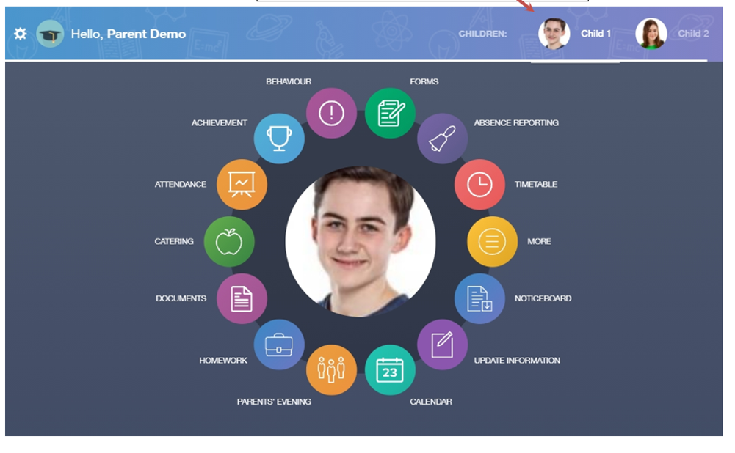
Working Together
EDULINK
Notes:
The achievement is where you can view information on positive achievements that have been awarded to your child
The behaviour button will give you access to view behaviour records, detentions and lesson behaviour,
The detentions tab will show you any detentions which have been assigned to your child, including the date, start and finish times, the location
The timetable section shows you information on what lessons your child has each day and who the teachers are for those lessons
The homework section is where teachers set homework tasks. Students can see what homework has been set when it is due and they can also mark it as completed
You can fill out a form sent by the school in the Forms icon. Schools will send out forms for many reasons: school trips, meal selection, permission forms etc
The noticeboard is where parents can see news and upcoming announcements from the school. The schools newsletter ‘This Week @ Wyvern’ will appear here.
Calendar section - Here you can see the events that are going on at the school, such as term dates, staff training days, school events and more

Slide 5
A Wyvern Education
Curriculum
English 7 | Maths 8 | Science 6 | French German 4 | D&T 4 | PE 4 | Geog 3 | History 3 | RPS 3 | Art 2 | Drama 2 | Music 2 | ICT 2
Key Stage Three is made up of years 7 and 8.
Students study 13 subjects.
The transition Curriculum helps students with low attainment in reading and writing.
Notes:
Curriculum. 13 different subjects
2 week TT of 50 lessons. See how many lessons students get for each subjects over the 2 weeks.
MFL – allocated either French or German but if you have a family reason for one then let us know.
D&T – one lesson per week will be food and textiles; one will be workshop.
RPS – explain
Key stage 3 Y7 and y8. Students choose their options in y8 and then have 3 years to study the subjects they have chosen in their options.
Try everything and see where their interests and talents lie.
Subject specialists – well staffed. Specialist rooms.
Big difference form junior school – lots of different subjects and lots of different places.
Some students join us well below age related expectations in reading and writing. Already been testing students in Y6 in their junior schools.
Work in our transition groups English, Geog and History lessons with Mrs moon and Mrs harder.
First introduced this two years ago – students in Y8 – remarkable progress and made significant difference to their reading and writing. Proud of them.
Most subjects – mixed ability classing.
Maths and MFL do set based on attainment.

Slide 6
A Wyvern Education
Extra-Curricular Activities
Colouring Club Art & photoshop Club Chess Club Concert Band Dance Club
MFL Club Music Tech Club Creative writing club History club IT Club
Dungeons & Dragons Teen Gym Pokemon Club Choir Textiles Club
Wyvern Pupil Press Warhammer Club Debate Club Gardening Club Rock Club
Ensembles Drama Club Science Club Basketball Football Cross Country
Netball athletics Rugby
Notes:
It is that passion which drives them to offer every possible opportunity to them.
Here are just some of the clubs on offer.
Getting your child involved in extra curricular activities – whether it is inside school or outside gives them confidence, a sense of self worth, sense of achievement, positive friendships across ages built on common interests; gets them positive attention from those who share their interests and all these things enables them to resist – to protect themselves- from negative peer pressure. It is the best way to bully-proof your child.
Students cant just expect to turn up in Sept and fit in. they have to work at it. And the work they need to do is to get involved. By getting involved in clubs and activities they will develop a positive sense of belonging.
If they give nothing they will get nothing; if they do nothing positive, they will feel nothing positive.
I have seen shy and unsure children join us in Y7 and transform into actors of great stage presence, public speakers with a confidence and character way beyond their years; sportsmen and women of fearless endeavour;
We run lots of clubs. We have activities in sport and the performing arts (dance, drama, music) which lead to public performance. We have Teams and tournaments; choirs, ensembles bands. School production – Shrek this year, Lion the witch and wardrobe next year.
Also Subject specific clubs like History club, Science club, Art club, IT club.
Clubs for special interests – dungeons and dragons, Warhammer, chess, pokemon, gardening; creative writing, photoshop, debate club.
So, please encourage your child to take part and get involved. For the sake of their happiness at college. For the sake of their personal development.

Slide 7
A Wyvern Education
STRIVE Award
 | Year 7 STRIVE | Year 8 STRIVE
S | Strength of Character | Scholarship
T | Teamwork | Teamwork
R | Responsibility | Respect
I | Initiative | Inspiration
V | Volunteering | Volunteering
E | Enrichment | Environmental
Notes:
First 25 minutes of every day is tutor time.
On Mondays, they will meet here for assembly.
On Tuesdays they will time for the tutor group to spend some informal time together,
On Wednesdays they will do their STRIVE work
On Thursdays they will do their respecting rights discussion on rules, behaviour, friendship choices, bullying, peer pressure
On Fridays they will do a series of different units of work on current affairs, on careers education and literacy.
STRIVE – one day a week in tutor time. Students will spend time working on the 6 units.
Learn about these 6 personal qualities. Students then set personal challenges to do that will allow them to demonstrate them and then get accredited for them. Bronze Strive award in Y7.
Eg enrichment - Way of promoting, monitoring and rewarding their involvement in extra-curricular activities – both those that take place in college and those they do outside of college.
Recently students completed their volunteering section: coaching football; working in special school on INSET days; community litter picking; fundraising for charity
Tutor time – ABL. Adventure based learning.
Physical games and challenges to develop team work. gym, using gym equipment. Problem solving, iniative. Great fun.

Slide 8
The Pastoral System
Mrs Goss
Assistant Head teacher, Pastoral
Mrs Taylor-Waterson
Pastoral Leader Year 7
Mrs Munday
Pastoral Assistant Year 7
Form Tutors
Notes:
Form tutors -
Establishing and maintaining the relationship between the child and the school, Make students feel cared for, listened to, and valued
Encourage positive contributions to the school community. Set high expectations for behavior and academic performance, adopting a mentoring approach
First point of contact for parental concerns and information sharing
Maintaining standards for equipment, behavior, and uniform - Conduct equipment and uniform checks regularly and work with parents to quickly address issues before they become bad habits
Supporting the school in maintaining high levels of attendance and punctuality
Supporting tutee personal development through delivering high-quality PSHE/SMSC/careers content via the tutor time curriculum
Pastoral Leader and Pastoral Assistant
Mrs Goss and Mrs Munday have just finished being the pastoral leader and pastoral assistant for Y11. Their year group achieved over 250,0000 achievement or praise points in their 5 years at Wyvern – the best any year group has ever achieved.
Normally they would both now become PL and PA for Year 7 but Mrs Goss is now my Assistant Head teacher for pastoral.
And I am very pleased to have recruited Mrs Taylor Waterson from another school. She is an experienced pastoral leader.
Mrs Munday has been TA PA and a parent of students at Wyvern.
All three are experienced safeguarding members of staff.
Strong pastoral team.
Who do you contact for what?
Tutors – first port of call. Contact them initially.
When to contact PA and PL

Slide 9





A Wyvern Education
House System
Phoenix
Gryphon
Centaur
Dragon
Hippogriff
Strong
resilient
hopeful
Protective;
guardian
against evil
Gentle helpful strong
Wise
intelligent powerful
Proud
loyal
respectful
Notes:
House system is new.
Introducing it to create an even stronger sense of community, identity and belonging – lots of activities planned not just in sport but in all curriculum areas.
We hope it will incentivise students to achieve more praise points and rewards. Foster co-operation, team work, friendly competition.
Two tutor groups in y7 will belong to Phoenix, 2 to Gryphon, 2 to centaur, 2 to Dragon and 2 to hippogriff.
That is the same in years 8, 9 10 and 11.
Competition to design the logos for the houses.

Slide 10
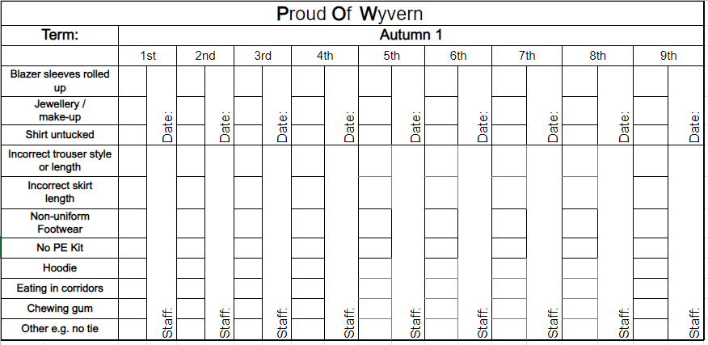
A Wyvern Education
POW Cards
Notes:
We are strict in uniform.
We expect students to wear it smartly and we will challenge them on it when they don’t.
POW cards are Pride of Wyvern cards.
Each time a teacher sees a students incorrectly wearing it – POW card is ticked. For every three ticks – detention is set.
Why are we so strict on uniform?
Because when we allow students to wear jewellery or expensive variations of the college uniform items we put on public display for everyone to see the difference between rich and poor, between those who come from families where they can afford expensive things and those who come from families where they cant/ We have students whose families cannot afford to buy uniform – we help them. We have children who don’t want to come to college on non uniform day as they are too embarrassed by the clothes they have to wear. Life has already taught these children more than they should know about feeling inadequate – not good enough. They don’t need that being reinforced at college by people flaunting fashion and wealth.
Similarly, when we allow students to wear fashionable variations on the uniform, we put on display those who are fashionable and those who are not. That create speer pressure and the breeding ground for bullying. And the pressure for students to then go home and tell their parents to buy them the fashionable variations because “everyone else if wearing them.” This creates conflict between students and parent, most of whom want to support the college high standard sin uniform. To be honest we could all do without this hassle in our lives.
In year 7 and 8 students don’t wear make-up. We do not want 12 year olds operating in a school culture where they feel they have to wear it to feel good about themselves. We
Either a decide to be complicit in that culture and reinforce the view that 11 and 12 year old have to wear make up to feel good about themselves. Or we challenge it Here at Wyvern, we challenge that. They are worth more than that and its our job to help them see that.

Slide 11
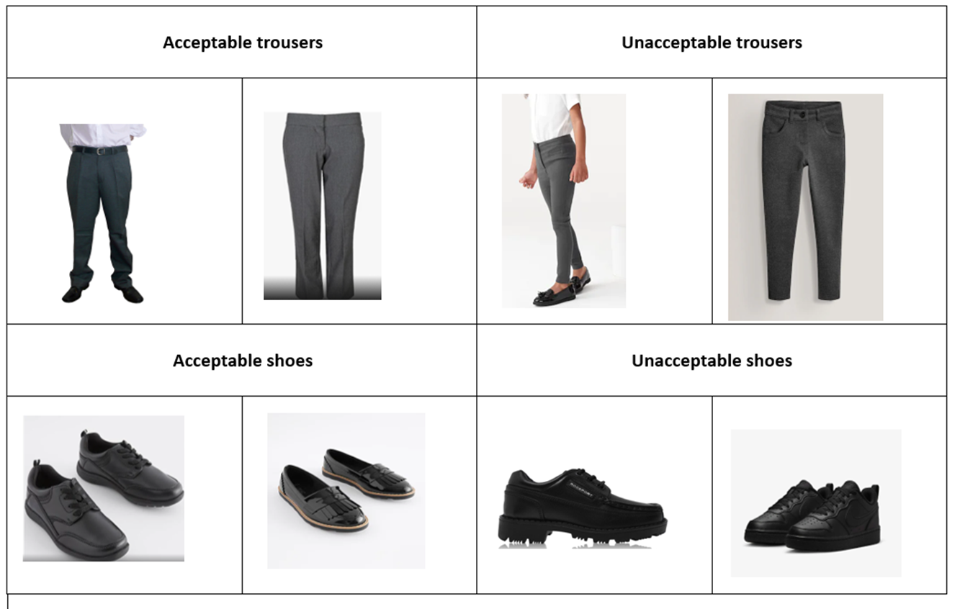
A Wyvern Education
Uniform

Slide 12
PRIDe: Behaviour Expectations
Warm Strictness; Tough Care
Prepared |  | Respectful |  | Involved |  | DEdicated
On time, correct seat Correct uniform Correct equipment Prepare the page |  | Follow instructions first time, every time Listen in silence Wait your turn Be polite and kind |  | Sit up, listen, focus Ask/answer questions Actively contribute Help each other |  | Stay work focused Neat presentation Persevere: keep trying Act on feedback
Notes:
At Wyvern Standards of behaviour are high. Some families think we are too strict. Children who come to us from other secondary schools say the same. But we are warmly strict. We are kind, friendly, supportive and encouraging. Have good relationships with students. But we will insist on our pride rules.
One reason why so many teachers want to work at our college.
One common set of expectations in every classroom: every student, every lesson, every day.
Maintains relationships between staff and students.
Everyone knows what’s expected, we can get on with teaching and learning.
PRIDe behaviours – strong correlation to results. PRIDe reports. Rewards/praise
Weekly PRIDe tutor time – what, why.
Key message I will be giving your children: at college they don’t follow home rules; they follow wyvern rules. Irrespective of how they behave at home, when they put on our uniform, they behave like this.
By coming to this college, they need to accept that’s how things are done here. Just like when they get a job, they accept the rules and conditions of the workplace
We don’t negotiate on these rules; we don’t compromise. There is no discussion to be had. Put simply, this is how it is.
When parents say to me you’re really strict, I show them these rules and ask them: what’s unreasonable about these? No-one has been able to answer that question.
The rules are not unfair. Protecting teaching, protecting learning and keeping people safe is common sense.
Tutor time programme, students will learn about what each of these rules mean, why we have them and what lessons would be like without them.
Send – reasonable adjustments. Two examples. Adhd child. Autsistic child.

Slide 13
Initial disruption
Repeated disruption
Serious disruption
Severe disruption
Student choice: any behaviour which breaks the PRIDE expectations, interrupting the flow of the lesson.
Consequence 1:
No logbook = reminder next step is C3
Student choice: a 2nd incident of behaviour which breaks PRIDE expectations.
Consequence 2:
No show in break DT = C3 (30 mins) detention.
No log book = C3 (30 mins) DT
Student choice: a 3rd incident of behaviour which breaks PRIDE expectations.
Have a phone out In class.
No show in C3 (30 mins) DT C3 (75 mins) detention.
Defiance to staff
No show at C3 (75 mins) DT = day in Isolation
Student choice: refusal to be parked in a buddy room for on-call or disruption of the buddy room.
Swearing at a member of staff /their decision
Conduct which directly endangers others’ safety.
Non-attendance at C3 (75 mins) detention.
Repeated incidents = removed from Wyvern
Repeated suspension = leave Wyvern
C1 verbal warning; logbook on front desk
C2 break detention (20 mins) in log book
C3 (30 mins) detention; buddy roomed
C3 (75 mins) detention; buddy roomed
Sanctions
The 4 Point Plan
C4 Isolation, off-site direction, suspension
Notes:
The 4 point plan s what teachers will use in lessons to manage behaviour.
If students break the PRRIDe rules then they are issued with a warning – a C1. Log book on desk as a visual reminder their behavoiur is being monitored.
If they break another PRIDe rule then they are given a C2 – a break time DT. Recorded in their logbook. Also in our behave management system.
Breaking PRIDe rules for a third time – C3 after school detention. 30 minutes.
However a single incident of defiance – of refusing to do what staff asks is a 75 minute DT.
DTs are after school. Although we do not need parental permission to se these and do not need to give 24 hours notice, we do not have same day DTs and we like it when you do support the sanctions.
In DTs, students undertake specific activities – reading fiction and non fiction texts with quesitons for them to answer. All the texts and activities have been chosen to develop students’ empathy, kindness, responsibility and respect and sense of gratitude for what hey have and what others do for them. Also some tasks on personal, social and health education.
Serious issues: isolation, suspension and alternative school placement – day or more in another local school..
Sanctions need to be proportionate to the behaviour. Sanctions are not just set for the students who has done something wrong, set to show people who have suffered from that behaviour that justice has been done; set to uphold the rules so that others can see they need to be followed.
Lots of help and support to get behaviour right.
Students behave better when we work together: student behaviour is worse if they know parents will challenge the sanctions set.
Fortunately we are able to praise and reward far more than we need to sanction.
Hope this helps you understand how it works.

Slide 14
Absence: Every Lesson Counts
Notes:
Attendance rates are the most significant factor in determining how well students do at GCSE, even more significant than their previous test scores, grades and marks. This is true of students in any year group, not just year 11. Even if GCSEs seem a long way off for your child, absence from lessons at any time and for any reason creates gaps in their learning. This makes it harder for them to understand the work when they return from their absence because this work builds on the learning they have missed. Learning gaps therefore grow and multiply. This in turn affects their motivation, their confidence and desire to attend school.
Don’t let your child take time off school for minor illnesses: particularly those that would not stop you from going to work.
Develop your child’s resilience by encouraging an attitude of “what can I do?” rather than one of “what can’t I do?”
You can prevent your child’s occasional day of absence developing into a habit of being absent by ensuring they aren’t spending the day on the xbox or on their phone.. When students enjoy things at home they do not get to do at school, of course they will prefer to be at home.

Slide 15
Absence: Every Lesson Counts
Attendance Rate | Number of weeks absent per year | Number of lessons missed peer year | Learning time missed across 5 years
95% | 2 weeks | 50 lessons | Almost 1 full term
90% | 4 weeks | 100 lessons | 1.5 terms (half a year)
85% | 6 weeks | 150 lessons | Three quarters of 1 yr
80% | 8 weeks | 200 lessons | 3 terms; 1 whole year
Notes:
The danger is we think of percentages in terms of test results. 95% in a test would be great. But 95% attendance means 50 lost lessons per year. 50 significant learning gaps. 50 things students don’t know which they need to know in order to learn new things.
Attendance rate of 90% means 100 significant learning gaps per year. And over the 5 years at Wyvern, missing half an academic year – half of year 11.
How can that not ruin students chances of doing their best
Please do not incentivise “sick days” by letting your child spend the day on their xbox or going out. This can encourage them to take more time off school.

Slide 16
Mental Health Anxiety
Emotional | Physical | Thinking | Behavioural
Panic Nervous Anger Fear Sadness Shame Guilt Hate others Hate yourself Low mood Depression | Headache Feeling sick Loss of appetite Tense muscles Shallow breathing Feeling thirsty Increased heart beat Feeling dizzy Feeling hot or cold Sweating Shaking Tummy ache | Believing the worst You think “what if…?” Can’t think of anything else Pessimism: only see negatives Unable to enjoy things Seeing yourself negatively Needing to punish yourself Believing you are a failure Thinking others hate you Thinking you’re not good enough | Unable to concentrate Biting nails, chewing lip Running away Hiding Self-harming Eating disorders Swearing Doing drugs or alcohol Hurting other people Being aggressive Freezing – can’t move Unable to speak
Notes:
In reception – you will see the quote, “Happiness is the new rich. Inner peace is the new success. Health is the new wealth. Kindness is the new cool.”
At some point, most children will feel anxious. A little anxiety if healthy but increasingly,
But mental health is something we cannot take for granted.
Most of your child will feel anity that affects them in some of these ways. At some point in their 5 years with us.
Anxiety can be a crippling problem, prevents people living life to the full.

Slide 17
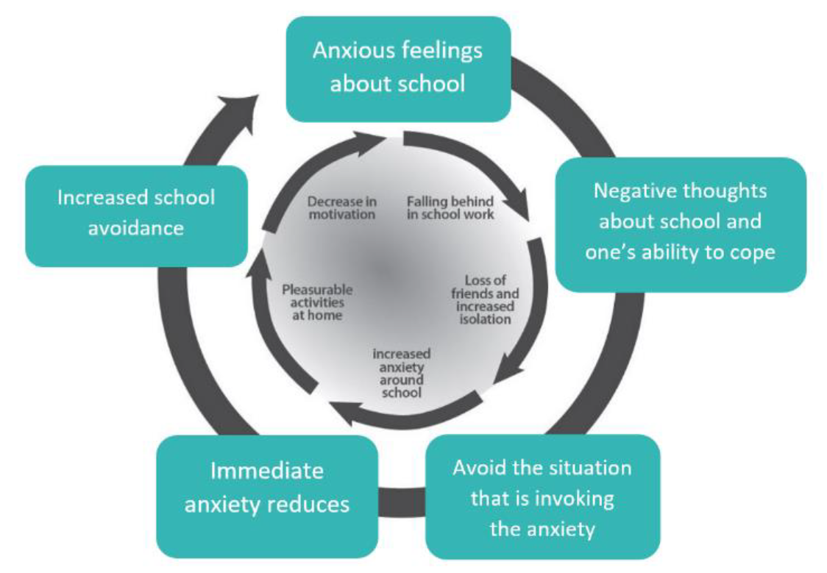
Mental Health Anxiety
Notes:
The most obvious thing is to avoid the situation, person or thing that makes your child anxious. However, this “solution” does more harm than good. It is true that your child will feel a strong sense of relief when you avoid what makes them anxious. But that relief is only short lived and the problem is that this short term relief makes them always want to avoid the thing. This approach means they swap feelings of anxiety for feelings of relief. The sense of relief that comes from avoiding the situation acts as a powerful re-enforcer for the avoidance of anxiety. The relief ‘rewards’ the avoidance behaviour while at the same time convincing them that they do not have the ability to handle the situation.
Over time, this increases the fear of the thing they are avoiding. What was once a genuine but small concern or worry about something grows out of all proportion to a huge dread where they have convinced themselves of the awfulness of the thing were once only were a bit worried about. When parents say things like, “I’m keeping my child off school until the college sort this out,” this simply makes their child anxious. Don’t promise a child that what they fear won’t happen — e.g. that you know they won’t fail the test — but do express confidence that they’ll be able to manage whatever happens.
The process of facing fears is called EXPOSURE, which involves gradually and repeatedly going into feared situations until your child feel less anxious. However, this needs to be stepped. If they face something too scary too soon, they will simply make their fear worse, not better. The key is to take small steps which build up towards overcoming what makes them anxious. So, for example, if they’re anxious about swimming, you could break things down for your child into these steps, with each step taking place on a different day:
Step 1: : get changed into swim wear and watch others swimming in the pool.
Step 2: get changed and sit on the side of the pool, with their legs in the water, watching others.
Step 3: stand in the shallow end of the pool, keeping the top half of themselves dry.
Then discuss with them what step 4 or 5 might be.
College staff will be keen to listen to your child’s anxieties and discuss these with them or you. We will acknowledge without validating their anxiety. We will listen to how they are feeling and be keen to plan with them, how we can support them to do the thing that makes them anxious. We will be prepared to offer them a stepped approach to doing the things that make them anxious. We will encourage them by reminding them they can overcome their anxiety.
What we wont do is remove the source of your child’s anxiety. We will not remove a child form a subject, change their class or teacher or exempt them from an event which they feel anxious about unless there is a safeguarding reason or issue to address

Slide 18
Mental Health Phones & Social Media
Sexting Sextortion Predators Grooming Pornography
Extreme Pornography Trolling Criminal Exploitation Cyber-bullying
Phishing Hazing Radicalisation Fake News Hate Speech
Misinformation Self-harm Glorification Suicide Promotion
Identity theft Prejudicial Influencers
Notes:
We have seen and the research is showing that more teenagers have social media addiction – one of the biggest causes of poor mental health. Quickly takes the place of all the things that lead to good mental health. Leads to a lack of physical activity, limited real life social activity and poor sleep. But also low self-esteem, negative body image, feelings of inadequacy – not being good enough; friendship issue
Social media platforms have set age restrictions. Children should be 13 to use Facebook, instagram twitter, Snapchat and Tik Tok. and and 16 to use WhatsApp.. This is because these platforms are often unsafe for children to use. To allow your child to use these sites is to expose them to all these dangers….
If you’ve made the decision to allow your child to access these sites, despite the age restrictions, then I’d like to politely and respectfully ask you 3 questions. Do you know what all of these dangers are? Does your child know what they are? Because these are the dangers they are now exposed to. What are you doing to protect your child from these dangers?
These things can happen here. They do happen here. You might say, well every child uses them. That is an excuse not a reason for your child to. I am not exaggerating the risks and dangers. Every week, my safeguarding team deals with the effects of them. They deal with students who are addicted to social media. Who have poor self esteem, low mood, depression, anxiety, self harm, Suicidal thoughts, eating disorders, harmful sexual behaviours, social isolation, loneliness, social comparison, feelings of inadequacy, disturbed sleep. Our work with teenagers confirms what countless pieces of research will tell you: that unregulated social media use is creating a mental health crisis for young people. Without restrictions, that will be your child. We live that reality every week. And there is no type of child who is affected by these. All types of children including those whose parents would never think they would be the type to access dangerous content are vulnerable
Our policy on mobile phones and smart watches – we don’t want to see them or hear them. If we do, we will confiscate them till the end of the day. When we will return them. If students need to use them they simply need to ask staff. Students to have 6.5 hours a day when they are not living an online life with virtual friends and virtual experiences but where they can enjoy real life with real people.
Children want unregulated access to social media. They will resist and argue about you limiting screen time, putting blocks and controls on what they can access, checking what they have been saying and doing and stopping them from taking their phone to bed. They will talk about their rights and their privacy. They will tell you everyone else uses their phones all of the time. But as the responsible adult in their life, you must take control and set boundaries. For the sake of their mental health.
We are not responsible for what your child or other children post about each other on social media in the evenings or holidays and at weekends. It’s not our job to police that. We don’t have the staff, the time or the powers to police what 1350 students do with their phones 365 days of the year.
That is for you to do, in partnership with the social media providers and where appropriate, the police.
We are responsible for your children when they are at school and on their way to or from school. We will only have a role in online abuse and conflict when it is brought into college or is a continuation of conflict taking place in college. We will always provide safeguarding support for students, including educating them on the dangers of social media, but we need you to do your bit too please by regulating their phone use and limiting their screen time.

Slide 19
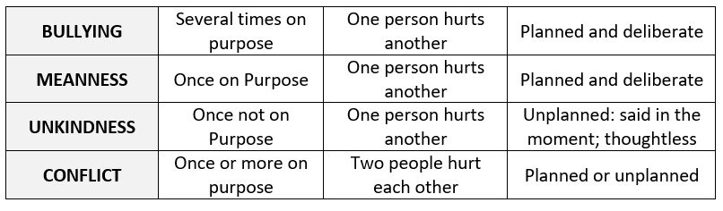
Mental Health Bullying
“Bullying is repeated negative behaviour that is intended to make others feel upset, uncomfortable or unsafe.”
Notes:
The table below shows the 4 negative behaviours which we want you to report to us and which we will sanction. The first of these behaviours is bullying, which has all the parts to the definition above – repeated, hurtful, intended. We distinguish between these 4 behaviours because how we respond to them will be different
Each year, we see more of the four negative behaviours in year 7 than any other year group and we see these negative behaviours fall significantly as students go through the college. In some cases, groups of students have behaved like this in their junior school and this behaviour has become normalised. As students find their feet in a new school, some year 7s can sometimes feel they need to behave like this to be accepted: that to make themselves look good, they have to make others look bad; that to prove they do belong, they have to prove that others don’t; that to prove they do fit in they have to show that others don’t.
We work hard on preventing bullying. In tutor time in the first term of year 7 we teach students how to identify, report and prevent bullying. This unit of work helps them develop a strong understanding of the following: what bullying is and the devastating effects it can have on victims; the ways in which good friends differ from toxic friends; how cliques, banter and peer pressure can lead to bullying within friendship groups; the reasons why bullies bully; how students can respond appropriately to it and report it safely without fear of reprisal; how by becoming upstanders rather than bystanders students take away bullies’ power and opportunity to bully.

Slide 20
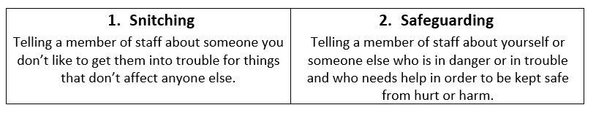
Mental Health Bullying
Sanction | Support | Monitor | Educate
Notes:
Help your child understand the difference between “snitching” and “safeguarding”. We will teach them this and it is really helpful if you reinforce it. Bullies thrive when students believe that helping others is snitching. This word has been invented by bullies for this purpose. This is what we teach your child:
When students report bullying they are not snitching, they are safeguarding. Because the effects of bullying can harm ta child’s wellbeing. Encourage people to report bullying they see happening to others. Upstanders. Anti-bullying ambassadors. This means that when students who have bullied are challenged by us, we can say it has been reported by other, not by the student whose been targeted.
We will follow up on reports of the 4 negative behaviours. With bullying we will do these things:
SANCTIONS
We decide on sanctions depending on how serious and how repeated the bullying is. The sanctions are tough, including: 75 minute detentions, days sent in isolation (IER), suspensions and permanent exclusion (expulsion). We also can get the person doing the bullying behaviours to sign a behaviour contract and warn them of how the sanctions will get tougher and tougher until they stop the behaviour. We can, have, and will, permanently exclude any student who repeatedly bullies others and who has not responded to the support and help we have given them to change their behaviours.
SUPPORT
We support the person who is the target of the bullying behaviours by creating a safe and supportive environment around them. We provide safe spaces and safe people such as their Pastoral Leader, Pastoral Assistant and Anti-Bullying Ambassadors to help them. We may enforce a separation strategy where the person doing the bullying behaviour is not allowed in certain parts of the college and may be moved out of the target person’s classes.
MONITOR
Once we have dealt with the reported incident of bullying, we make sure that we continue to monitor the situation so that we can act quickly and more firmly if it happens again. We ask people who have been the target of bullying behaviours, and their parents, to report any further instances. We also arrange for the target’s tutor to regularly check in with them to make sure that they bullying has stopped.
EDUCATE
Often people bully others because there is a problem in their own life. We interview the person doing the bullying behaviour to try to understand why they acted the way they did and if they need support with a problem in their own life we help if we can. We also educate them on the negative effects that bullying can have on people. These are all things we do to try to prevent the bullying from happening again

Slide 21
A Wyvern Education
Key Dates
Thursday 11th July
SEND information evening 6pm-7pm
Tuesday and Fridays in summer holidays:
Second hand uniform for families where students are entitled to free school meals.
Tuesday 3rd September:
Year 7 first day of term – only year 7 are in on this day (with year 11 prefects)
Tuesday 24th September
Year 7 parent information evening
Monday 7th October
Year 7 activity day
Thursday 9th January
Year 7 parents’ evening

