Slide 1
What is an apprenticeship?

Slide 2
What is an apprenticeship?
Working → Experience
Learning → Qualifications

Slide 3
An apprenticeship is…
Paid work
A real job
For everyone
No fees to pay

Slide 4
An apprenticeship can…
Lead to
progression
Support a great social life
Allow you to relocate
Not an easy option

Slide 5
What kind of apprenticeships are there?
Accounting
Aviation
Horticulture
Architect
Hairdressing
Teaching
Hospitality
Surveying
Journalism
Nursing
Dental Nursing
Cyber Security
Creative & Digital
Legal Services
Project management
And many more….

Slide 6
Which employers offer apprenticeships?

Slide 7
The levels of apprenticeships
LEVEL
LEVEL
Intermediate
apprenticeship
Level 2
Advanced apprenticeship
Level 3
Higher apprenticeship
Level 4-7
Degree apprenticeship
Level 6 & 7
Intermediate
apprenticeship
Level 2
Advanced apprenticeship
Level 3
Higher apprenticeship
Level 4-7
Degree apprenticeship
Level 6 & 7
SKILLS, KNOWLEDGE & BEHAVIOURS
SKILLS, KNOWLEDGE & BEHAVIOURS

Slide 8
Off-the-job training
Workplace learning
Online learning
20% of your time off-the-job
learning
Classroom learning
Attend college or training provider

Slide 9
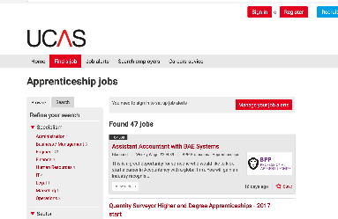
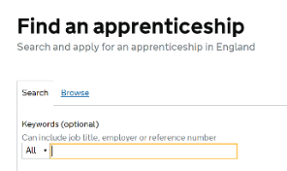
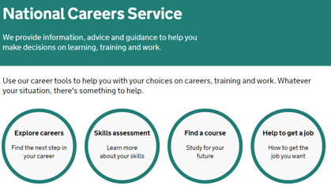
Do your research – where to look
AmazingApprenticeships.com/vacancies
GOV.UK Find an Apprenticeship

Slide 10
Contact us
Follow the National Apprenticeship Service: @Apprenticeships
Fireitupapps
National Apprenticeship Service
Search for apprenticeships on GOV.UK or call 08000 150 400

