Slide 1
Pathways into
Apprenticeships

Slide 2
Pathways into apprenticeships
Traineeships
Work experience
T Levels
Applying for a vacancy directly

Slide 3
What is a traineeship?
16 to 24

Slide 4
What support will you get from the Training Provider or College?
Training to prepare you for work
Help with applying for jobs
Support to prepare your CV
Support to improve your English and maths

Slide 5
What support will you get from the Company?
Work placement
Interview
Tailored to you
Supported by the employer

Slide 6
What are the benefits of doing a traineeship? https://vimeo.com/222357782

Slide 7
You may get extra support
Expenses for travel
Financial support
Support from JCP

Slide 8
What happens at the end of my traineeship? https://vimeo.com/221742256

Slide 9
What kind of traineeships are there?
Finance
Sport & Fitness
Horticulture
Health Care
Media
Business Admin
Retail
Warehousing
Electrician
Hairdressing
Painting
Customer Service
Catering
Hospitality
IT
And many more….

Slide 10
What do I do next?
https://www.gov.uk/find-traineeship

Slide 11
Where else can I look for a traineeship?
Ask you local college or training provider
Speak to your school or college Careers Adviser

Slide 12
Work experience

Slide 13
T Levels

Slide 14
T Levels
www.tlevels.gov.uk

Slide 15
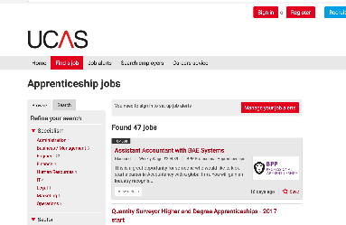
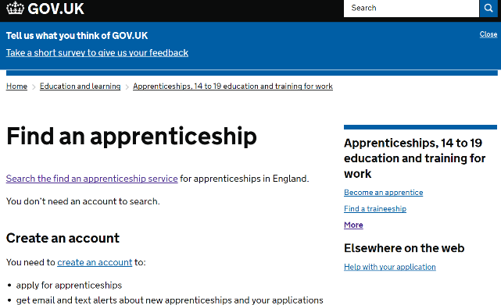
Applying for apprenticeships
Find an Apprenticeship
Employer websites
Amazingapprenticeships.com/vacancies

Slide 16
Contact us
Follow the National Apprenticeship Service: @Apprenticeships
Fireitupapps
National Apprenticeship Service
Search for apprenticeships on GOV.UK or call 08000 150 400

