Slide 1
Higher & Degree Apprenticeships

Slide 2
The levels of apprenticeships
LEVEL
LEVEL
Intermediate
apprenticeship Level 2
Advanced apprenticeship
Level 3
Higher apprenticeship
Level 4-7
Degree apprenticeship
Level 6 & 7
Intermediate
apprenticeship
Level 2
Advanced apprenticeship
Level 3
Higher apprenticeship
Level 4-7
Degree apprenticeship
Level 6 & 7
SKILLS, KNOWLEDGE & BEHAVIOURS
SKILLS, KNOWLEDGE & BEHAVIOURS

Slide 3
How do apprenticeships compare to full time university?
HIGHER AND DEGREE
APPRENTICESHIPS
Work full time and study part-time
100+ UNIVERSITIES
Learning
Salary
No Debt
NUS
Experience
4-6 Years
University fees paid by employer and/or government

Slide 4
Degree apprenticeships available
Chartered legal executive
Aerospace engineer
Architect
Dietitian
First officer pilot
Marketing manager
Paramedic
Social worker
Project Manager
Teacher
Solicitor
Registered nurse
And many more….

Slide 5
Degree apprenticeships coming soon…
Creative digital designer
Occupational
therapist
Artificial intelligence (AI) data specialist
Dispensing Optician
District Nurse
Radiation Protection Scientist
Clinical academic professional
Geotechnical engineer
Air traffic controller
Church minister
Harbour master
Storyboard artist
And many more….

Slide 6
Which employers offer apprenticeships?

Slide 7
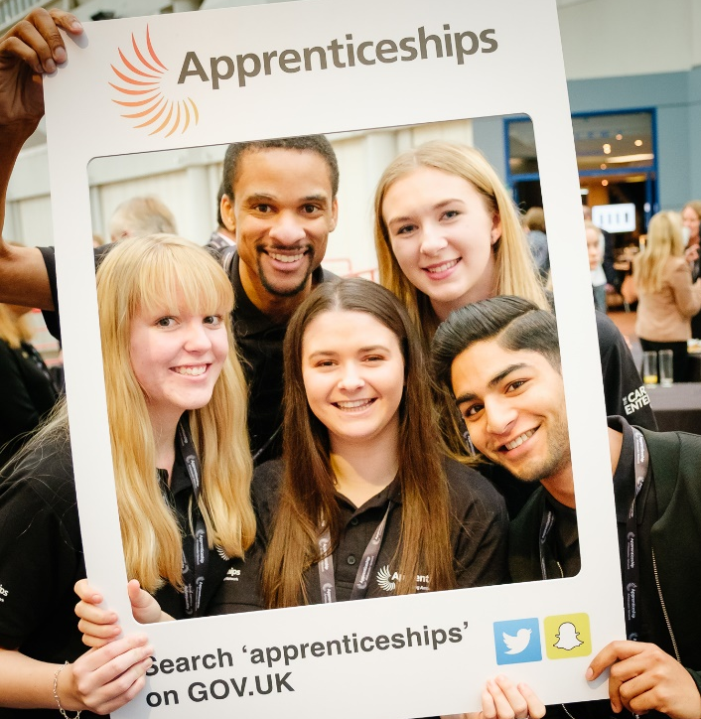
Life as an apprentice
AmazingAppsUK
1,234
Life as an apprentice

Slide 8
How to find a Higher/Degree apprenticeship?

Slide 9
Where else to look?
WHERE ELSE TO LOOK?
Social media
Your friends and family
The company website

Slide 10
Different delivery models
Workplace learning
Online learning
20% of your paid time for off-the-job
learning
Classroom learning
Attend college or training provider

Slide 11
Contact us
Follow the National Apprenticeship Service: @Apprenticeships
Fireitupapps
National Apprenticeship Service
Search for apprenticeships on GOV.UK or call 08000 150 400

Slide 12
Any questions?

