Slide 1
An Introduction to Apprenticeships for Parents

Slide 2
What are apprenticeships?
Earn a wage
Work for at least
30 hours per week
Study towards a
job related qualification
Contract of employment
including holiday pay
Real job with real responsibilities

Slide 3
The truth about apprenticeships
EARN A
GAIN A
SALARY
DEGREE
90%
NO FEES
STAY IN
WORK
TO PAY
POST-APPRENTICESHIP
YOU CAN
Social life?
RELOCATE

Slide 4
The range of apprenticeships
Accounting
Aviation
Horticulture
Architect
Creative & Digital
Teaching
Cyber Security
Surveying
Project management
Nursing
Dental Nursing
Hospitality
Hairdressing
Legal Services
Journalism
And many more….

Slide 5
Which employers offer apprenticeships?

Slide 6
Look inside the company!
Logistics
IT and Cyber Security
Data Analytics
Sales
Business Development
Marketing
Human Resources (HR)
Finance
Legal
Facilities Management
Security
Customer Service
Training and Development

Slide 7
The levels of apprenticeships
LEVEL
LEVEL
Intermediate
apprenticeship
Level 2
Advanced apprenticeship
Level 3
Higher apprenticeship
Level 4-7
Degree apprenticeship
Level 6 & 7
Intermediate
apprenticeship
Level 2
Advanced apprenticeship
Level 3
Higher apprenticeship
Level 4-7
Degree apprenticeship
Level 6 & 7
SKILLS, KNOWLEDGE & BEHAVIOURS
SKILLS, KNOWLEDGE & BEHAVIOURS

Slide 8
Different delivery models
Workplace learning
Online learning
20% of your paid time for off-the-job
learning
Classroom learning
Attend college or training provider

Slide 9
How do apprenticeships compare to full time university?
HIGHER AND DEGREE
APPRENTICESHIPS
Work full time and study part-time
100+ UNIVERSITIES
Learning
Salary
No Debt
NUS
Experience
4-6 Years
University fees paid by employer and/or government

Slide 10
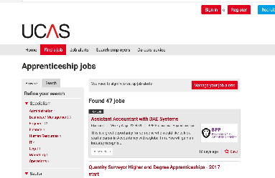
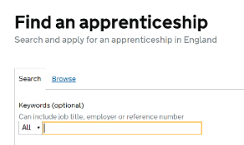
How do you find an apprenticeship?
1
4
Register on Find an apprenticeship
Manage
your alerts
2
5
Do your
research
Contact
companies
3
To find an apprenticeship visit
GOV.UK and search for apprenticeships
Search
and apply

Slide 11
Where else to look?
WHERE ELSE TO LOOK?
Social media
Your friends and family
The company website

Slide 12
How can I tell if it’s a ‘good’ apprenticeship?
What are they being paid?
What are the likely progression opportunities?
Is it a permanent or fixed term position?
Which training provider are they using?
Is the role varied?

Slide 13
Resources for parents
Monthly Parents’ Packs amazingapprenticeships.com
Translated Resources https://amazingapprenticeships.com/resources/

Slide 14
Contact us
Follow the National Apprenticeship Service: @Apprenticeships
Fireitupapps
National Apprenticeship Service
Search for apprenticeships on GOV.UK or call 08000 150 400

